Slide 1
Enhanced Entity-Relationship Modeling Transparencies
Database Systems
Specialization/Generalization

Slide 2
Introduction
The Enhanced E-R Model incorporates extensions to Chen's original E-R model. There have been literally dozens of proposed enhancements. We cover the most significant ones in these notes.

Slide 3
Specialization / Generalization
Superclass
An entity type that includes one or more distinct subgroupings of its occurrences.
Subclass
A distinct subgrouping of occurrences of an entity type.

Slide 4
Supertypes and Subtypes
Subtype: A subgrouping of the entities in an entity type which has attributes that are distinct from those in other subgroupings
Supertype: An generic entity type that has a relationship with one or more subtypes
Attribute Inheritance:
Subtype entities inherit values of all attributes of the supertype
An instance of a subtype is also an instance of the supertype
Sounds like object-oriented?

Slide 5
GENERALIZATION HIERARCHY -- Subtypes and Supertypes.
This is the concept of categorizing or generalizing between supertypes and subtypes of entities.
The basic notation used in McFadden, Hoffer and Prescott is shown in Figure 1.
The Supertype entity is connected to the Subtype entities through lines and a circle. The U-symbol indicates the Subtype is a subset of the Supertype.
All of attributes of the Supertype are also common to the Subtype.
Each Subtype entity has attributes that are unique to that Subtype - that is what makes the entity a subtype.
All entities share a common identifier attribute

Slide 6
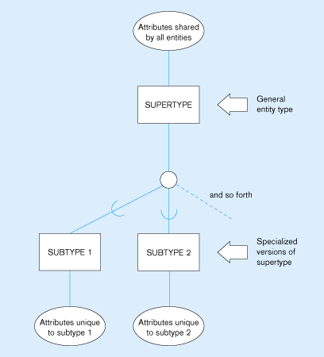
Figure -Basic notation for supertype/subtype relationships

Slide 7
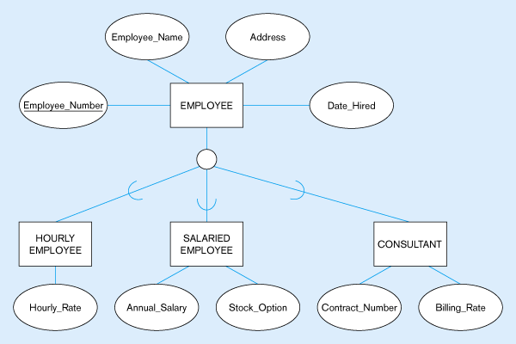
All employee subtypes will have employee number, name, address, and date-hired
Each employee subtype will also have its own attributes
Figure – Employee supertype with three subtypes

Slide 8
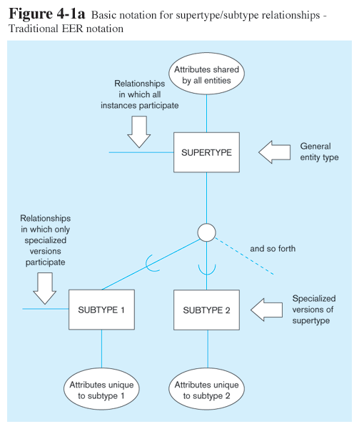

Slide 10
Relationships and Subtypes
Relationships at the supertype level indicate that all subtypes will participate in the relationship
The instances of a subtype may participate in a relationship unique to that subtype. In this situation, the relationship is shown at the subtype level

Slide 11
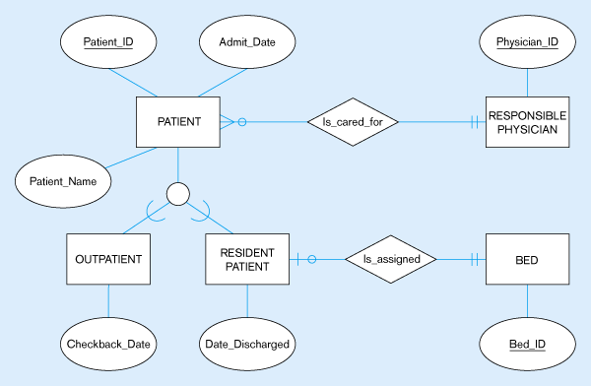
Figure – Supertype/subtype relationships in a hospital
Both outpatients and resident patients are cared for by a responsible physician
Only resident patients are assigned to a bed

Slide 12
Generalization and Specialization
Generalization: The process of defining a more general entity type from a set of more specialized entity types. BOTTOM-UP
Specialization: The process of defining one or more subtypes of the supertype, and forming supertype/subtype relationships. TOP-DOWN

Slide 13
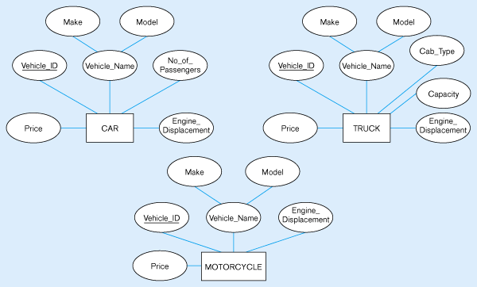
Figure – Example of generalization
Notice anything?
All these types of vehicles have common attributes

Slide 14
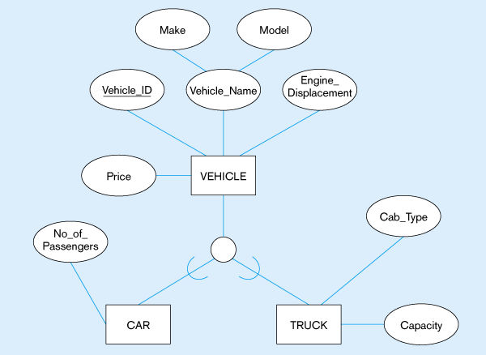
So we put the shared attributes in a supertype
Note: no subtype for motorcycle, since it has no unique attributes
Figure – Generalization to VEHICLE supertype

Slide 15
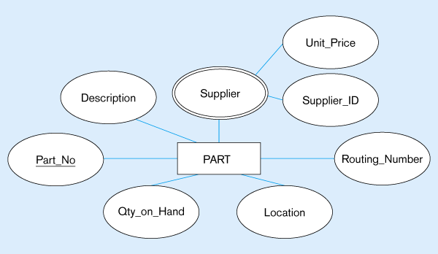
Applies only to purchased parts
Only applies to manufactured parts
Figure– Example of specialization

Slide 16
Specialization / Generalization
Superclass/subclass relationship is one-to-one (1:1).
Superclass may contain overlapping or distinct subclasses.
Not all members of a superclass need be a member of a subclass.

Slide 17
Specialization / Generalization
Attribute Inheritance
An entity in a subclass represents same ‘real world’ object as in superclass, and may possess subclass-specific attributes, as well as those associated with the superclass.

Slide 18
Specialization / Generalization
Specialization
Process of maximizing differences between members of an entity by identifying their distinguishing characteristics.
Generalization
Process of minimizing differences between entities by identifying their common characteristics.

Slide 19
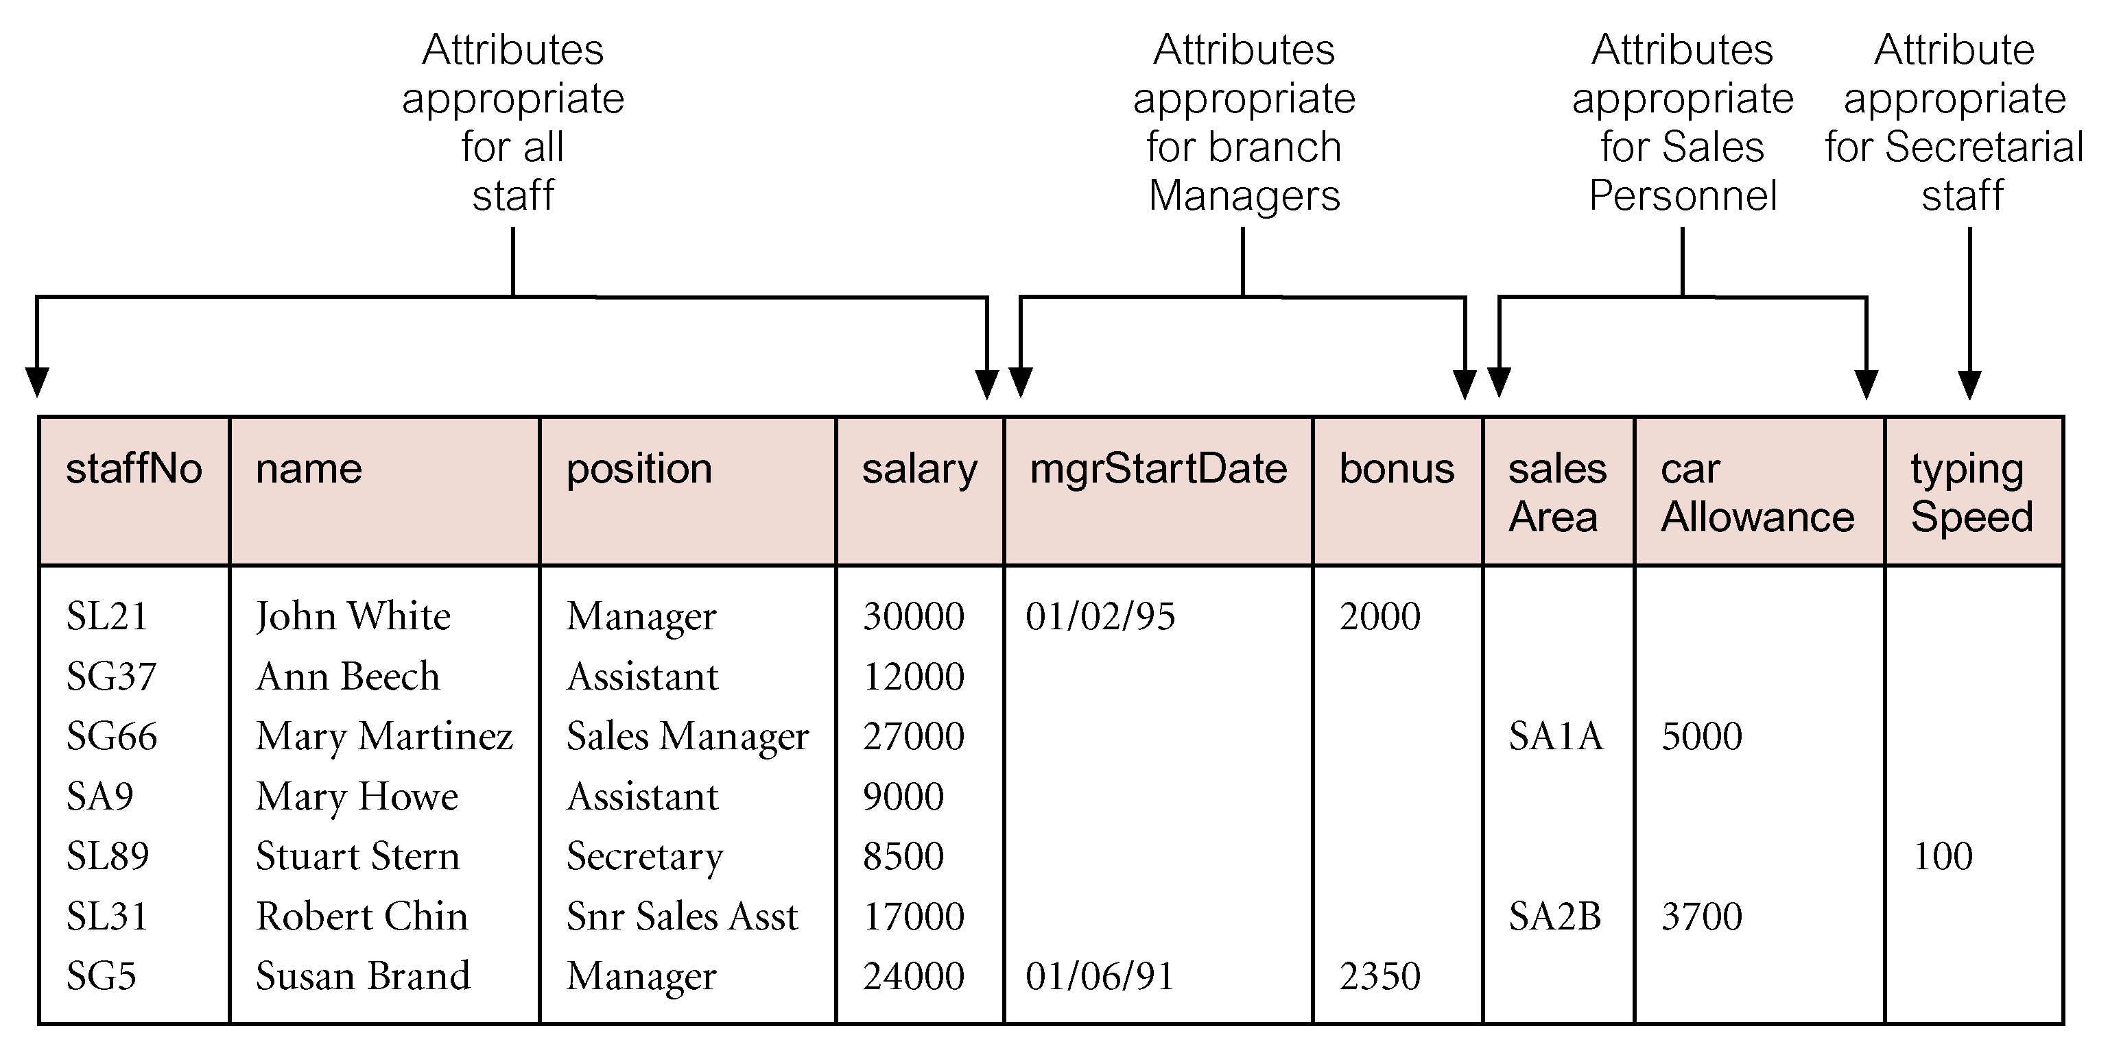
AllStaff relation holding details of all staff

Slide 20
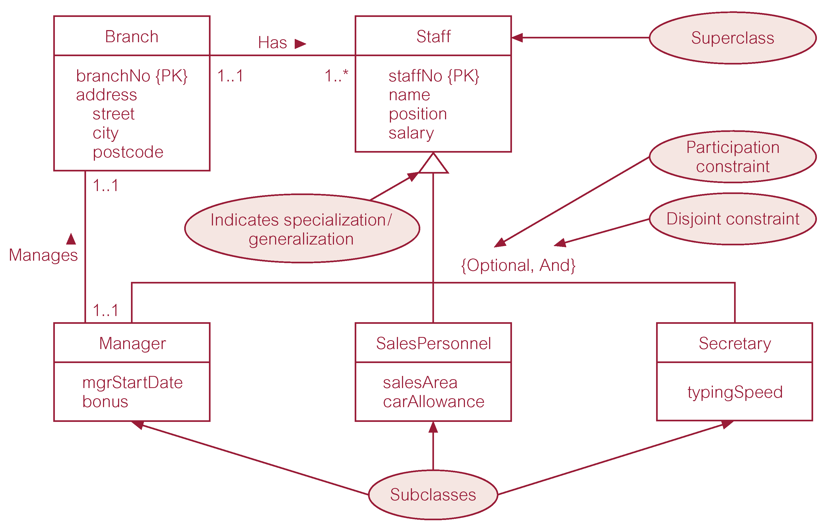
Specialization/generalization of Staff entity into subclasses representing job roles

Slide 21
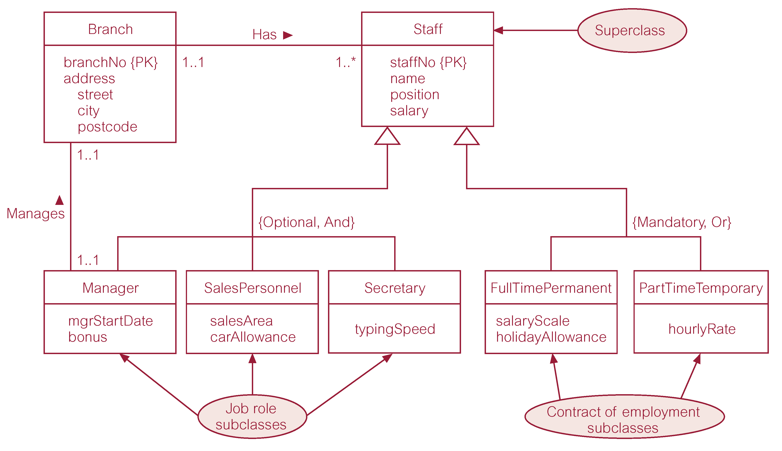
Specialization/generalization of Staff entity into job roles and contracts of employment

Slide 22
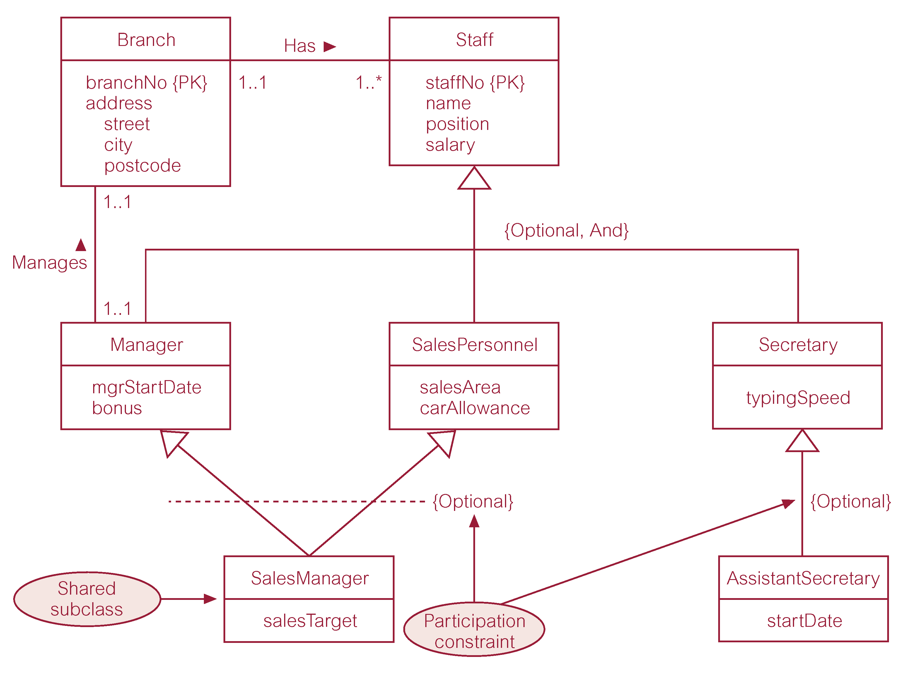
EER diagram with shared subclass and subclass with its own subclass

Slide 23
Constraints on Specialization / Generalization
Two constraints that may apply to a specialization/generalization:
participation constraints
disjoint constraints.
Participation constraint
Determines whether every member in superclass must participate as a member of a subclass.
May be mandatory or optional.

Slide 24
Constraints on Specialization / Generalization
Disjoint constraint
Describes relationship between members of the subclasses and indicates whether member of a superclass can be a member of one, or more than one, subclass.
May be disjoint or nondisjoint.

